Slide 1
Pinal County Air Quality Enforcement Action
AESA Compliance Assistance Seminar
February 15, 2018
Josh DeZeeuw Kevin Costello
Air Quality Manager Deputy County Attorney
520-866-6960 520-866-6270
joshua.dezeeuw@pinalcountyaz.gov Kevin.Costello@pinalcountyaz.gov

Slide 2
What You Should Learn Today
Pinal County enforcement process
Types of enforcement action
Common violations
How to avoid enforcement action

Slide 3
Overview of the Enforcement Process
Site inspection
Complaint
Random inspection
Report submitted to Air Quality Manager
Violations noted during inspection
Photos
Enforcement action is NOT determined at the site
Determination of enforcement route
Informal Notice of Opportunity to Correct (NOC)
Formal Notice of Opportunity to Correct (NOC)
Notice of Violation (NOV)

Slide 4
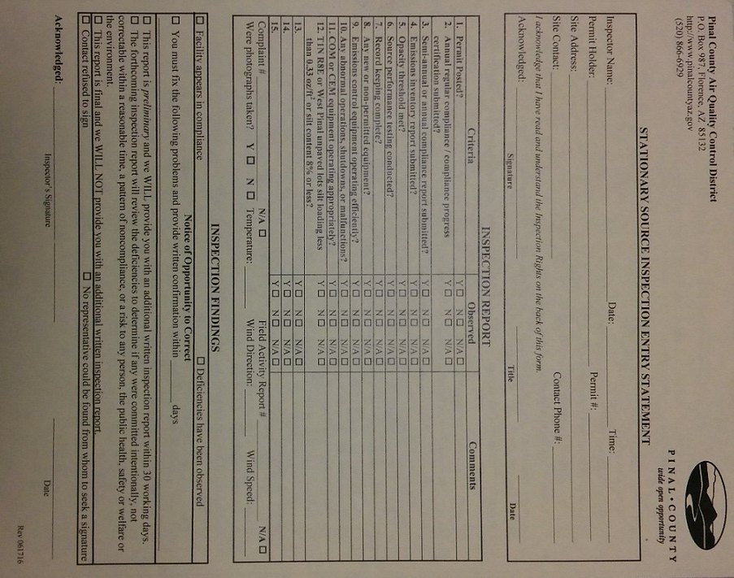
This is NOT a Notice of Violation . . . or a Ticket

Slide 5
Common Violations
Did not maintain the required records
Did not submit the required reports
Changed the process/equipment without a permit revision
Added capacity to the process without a permit revision
Did not maintain pollution control equipment
Did not conduct stack test (performance test)
Did not pay annual permit fee
Discovery of unpermitted equipment

Slide 6
Ways to Prevent Enforcement Action
Most Notices of Violation have a common thread:
The operator did not read the permit
The operator did not understand the permit
The operator did not include all equipment in original permit
The best way to prevent a Notice of Violation is to read your permit
Have a copy of your permit readily accessible
Thoroughly read the document
Call and ask questions

Slide 7
Informal Notice of Opportunity to Correct
Minor violation of a standard
Easily correctible
Not listed in ARS § 41-1009.E
Committed intentionally
Not Correctable within a reasonable period of time
Evidence of a pattern of noncompliance
A risk to any person, the public health, safety or welfare or the environment

Slide 8
Formal Notice of Opportunity to Correct
Gives the source 30 days to provide a written correction plan
The speed in which the plan is implemented will be reviewed
No penalty
No response or an inappropriate response may lead to a Notice of Violation

Slide 9
Notice of Violation
Used for more serious violations and when NOC failed to resolve the violation
Gives the source 30 days to respond
The response could refute the violations
The response could explain why the situation occurred
The response could explain how the situation has been resolved
Utilized when penalties are sought
No response could result in a referral to the Pinal County Attorney’s Office

Slide 10
Order of Abatement by Consent (OAC)
Utilized to collect penalties without going to court
If the two parties can come to an agreement, a settlement document is created
Defines the penalty and the date the penalty is due
Outlines any corrective actions that need to be taken
Lists the legal ramifications for failure to abide by the agreement
If the two parties cannot come to an agreement the situation may be referred to the Pinal County Attorney’s Office

Slide 11
Supplemental Environmental Project
An Order of Abatement by consent may contain a Supplemental Environmental Project (SEP)
The SEP is carried out as part of the penalty
Money spent to implement this project will count as a portion of the penalty
Clearly defined goals, reporting and milestones will be required
The SEP must result in emission reductions related to the violation

Slide 12
Questions?
Josh DeZeeuw Kevin Costello
Air Quality Manager Deputy County Attorney
520-866-6960 520-866-6270
joshua.dezeeuw@pinalcountyaz.gov Kevin.Costello@pinalcountyaz.gov

